Slide 1
Predictive Analysis of 20 Large Cap US Assets
Proj1- Team#09

Slide 2
Objective & Scope
Objective: To analyze the performance of 20 large-cap US companies that are leaders in their respective industry sector over a period of 10 years (2010 to 2019) alongside the S&P 500.
Scope:
Determine relative performance of assets’ returns over the 10 years period
Determine relative volatility or riskiness of the assets
Determine correlation among the assets and the S&P 500
Forecast expected price/return of a low risk asset and a high risk asset

Slide 3
Assets Included in the Analysis: S&P500 (^GSPC)
Industry | Asset 1 (Ticker Symbol) | Asset 2 (Ticker Symbol)
Banks | Bank of America (BAC) | Wells Fargo (WFC)
Integrated Oil & Gas | ExxonMobil (XOM) | Chevron (CVX)
Telecommunications | AT&T (T) | T-Mobile (TMUS)
Entertainment | Disney (DIS) | Netflix (NFLX)
Restaurants | McDonald (MCD) | Starbucks (SBUX)
Household Products | Procter & Gamble (PG) | Colgate-Palmolive (PL)
Pharmaceuticals | Johnson & Johnson (JNJ) | Pfizer (PFE)
Airlines | American Airlines (AAL) | Delta Airlines (DAL
Soft Drinks | Coca Cola (KO) | Pepsi (PEP)
Hypermarkets and Super Centers | Walmart (WMT) | Costco (COST)

Slide 4
A view of our work in Jupyter notebook
Price
Returns
Final data frame before cleanup.
(include updated examples from Jupyter notebook analysis).

Slide 5
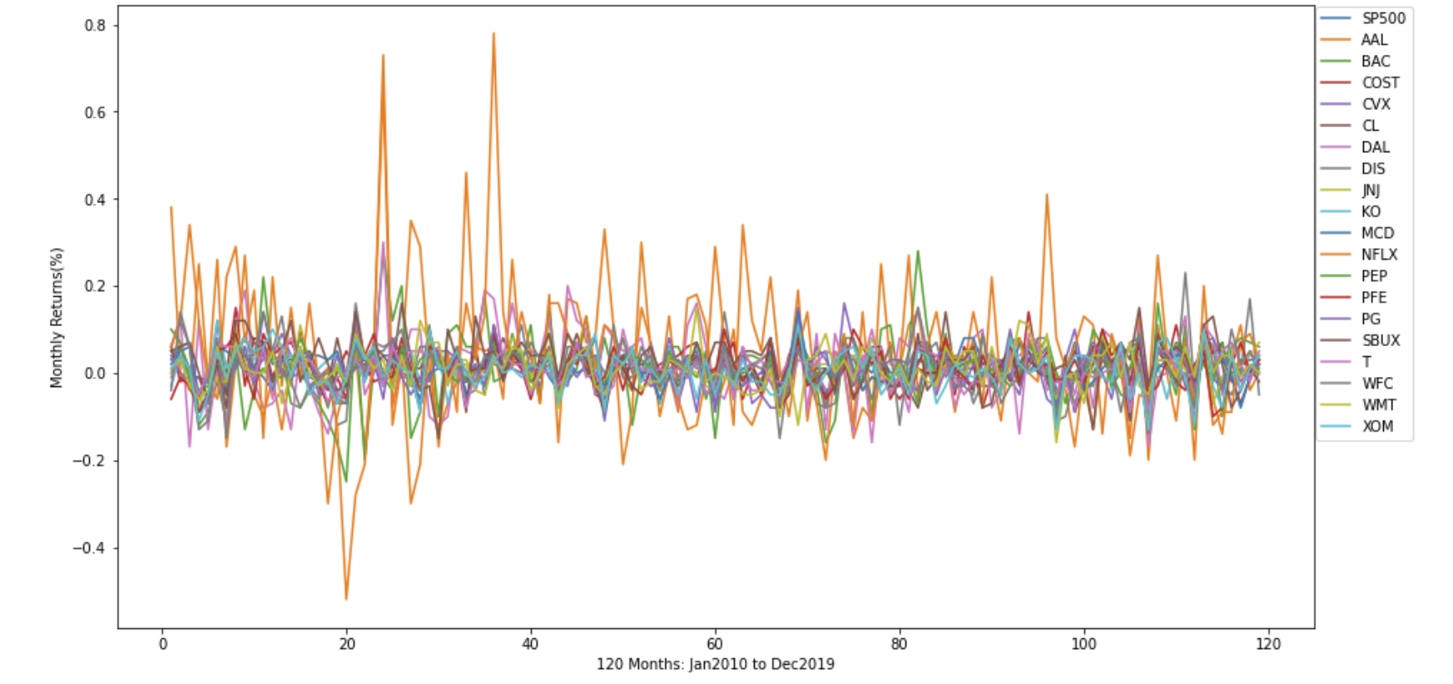
Plot of monthly returns of all assets
All assets are volatile and swing on average +/- 10% monthly
This only appeals to a day trader
Long term investors are mostly interested in cumulative returns
Cannot really use this view, as too much noise. Note: might need to take out the SP500.
Note: change the x_axis to convert to mm-YYYY. (in 2012, Netflix …)
Notes:
The highest peaks are not from SP500 – it is actually from Netflix.
”Cut the wire / Cut the cord” – that’s when Netflix started going off the trend.

Slide 6
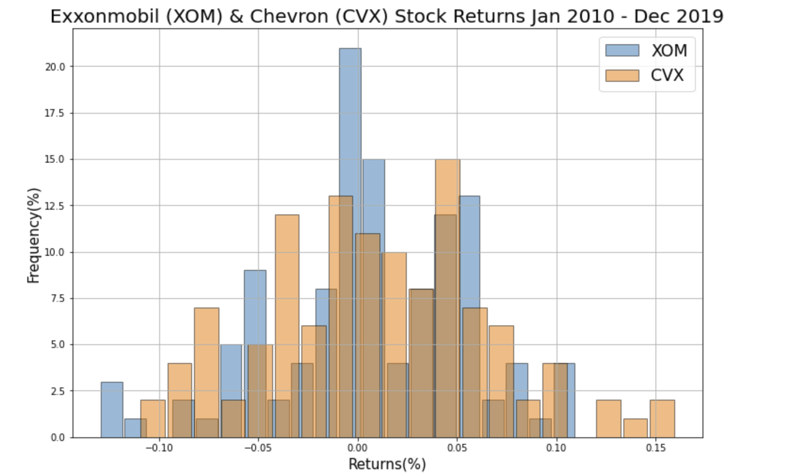
Monthly Return of 2 Oil & Gas Assets
Both assets have similar positive and negative returns
The intention is to use a different representation to avoid noisy data as in the previous graph.
Import updated graphs.
Notes:
This is a continuation of the previous slide. Now, when we look closer at two companies within the same industry, we can observe this behavior from the presented histogram plot.

Slide 7
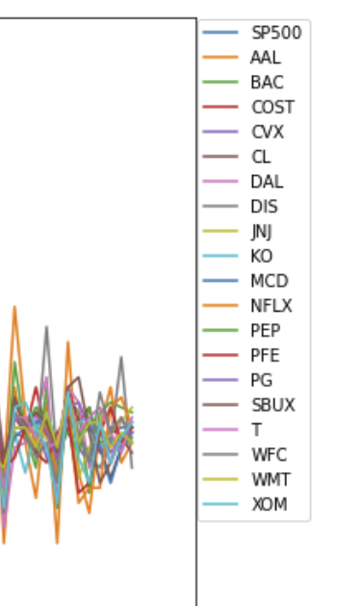
Plot of 10 years cumulative Return of all assets
All assets have >100% return within 10years
The best performing asset return >300%
The least performing asset return ~150%
Add all assets.
Import separate legend from previous graph.
Note: y_axis renamed to Returns (no %)
Notes:
Note: focus on accumulative returns. Where investors make or lose money. Long-term investors see 1.5 – 3.0 times the return over 10 years period.
Speculators capture gains on the volatility of short-term market movements.

Slide 8
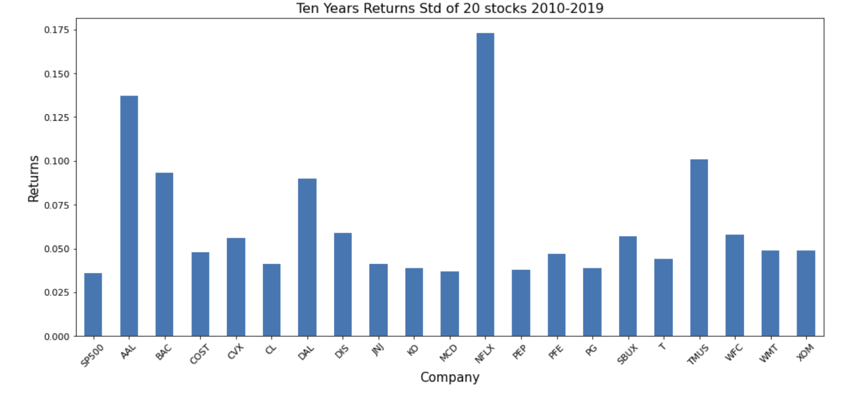
Relative Standard Deviation or Volatility
Only leave one plot.
Make the graph as big as possible.
Collect all figures in a separate folder.
All within 3.5 to 5.5% with the 2 oil & gas assets having the highest risk
Speculators and day traders love risky assets while long term
Notes:
This chart

Slide 9
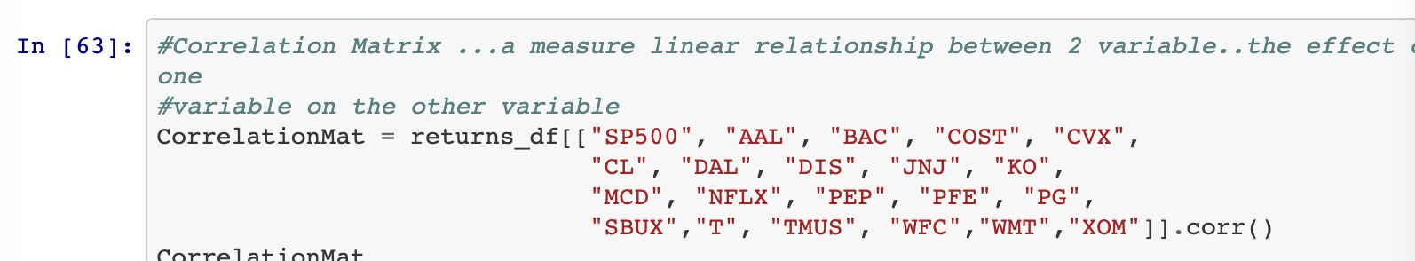
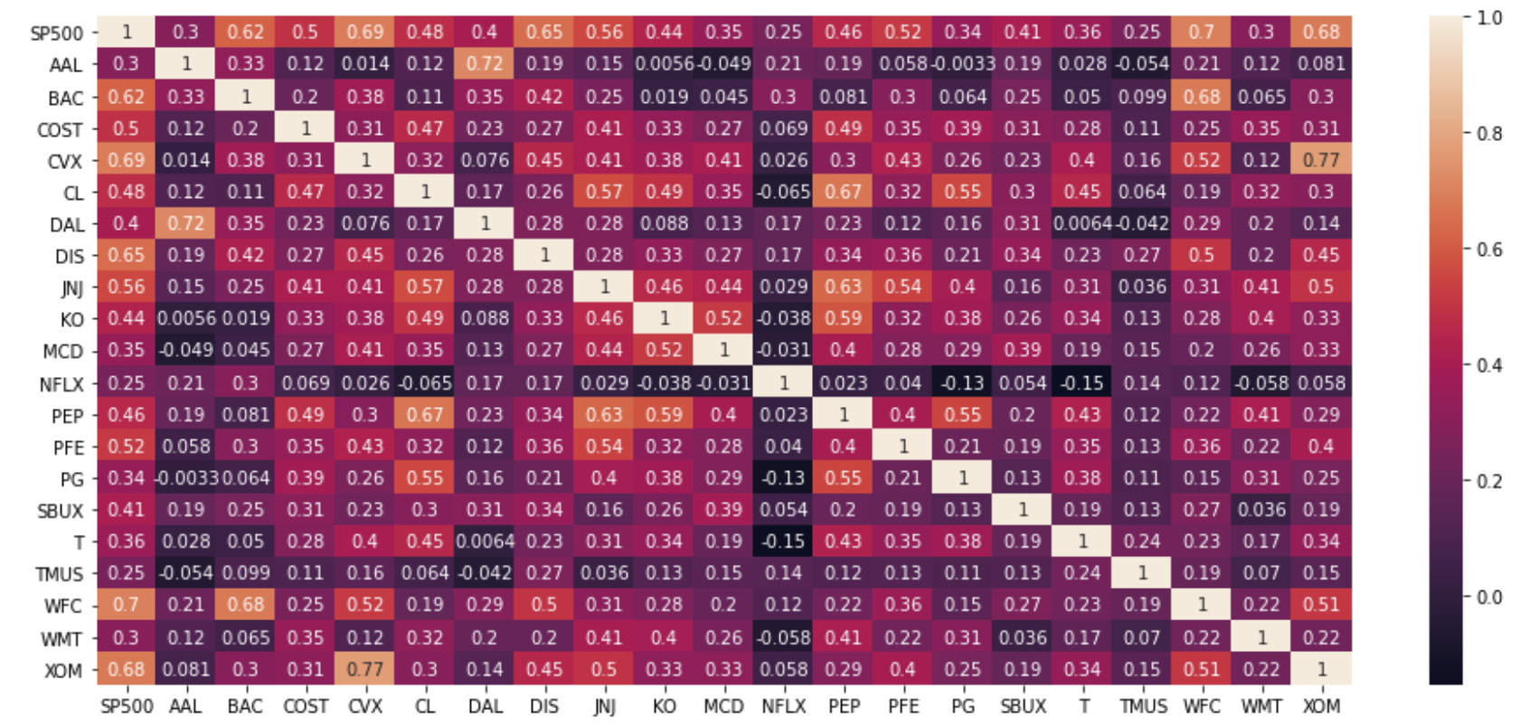
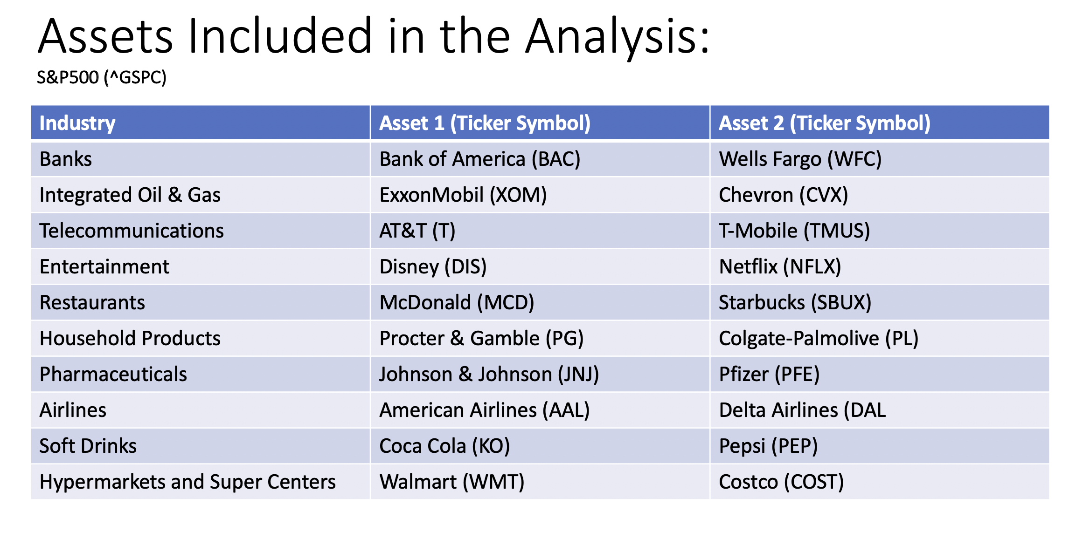


Correlation Matrix of All Assets
Highlight the correlating assets with better marking ☺. Re-arrange the assets to have assets from the same industries in pairs.
A measure of linear relationship between 2 assets…what is the impact of a change on one asset on the other asset?
Notice the level of correlation among assets within the same industry

Slide 10
Predict the future Price of 2 assets with relative high and low STD – CVX and PG
The actual closing price for CVX at the end of Jan 2020 is 104.37, while Feb is 90.93
The STD of CVX price is 18.1 the Jan forecasted price is within +/- CVX std, while Feb is outside the std. This can be attributed to the price war between Russia and Saudi Arabia that send crude price tumbling to the negative.
Keep the CVX but replace with an updated plot.
Note: open to change, if more interesting companies observed.
Notes:
Open

Slide 11
Predict the future Price of 2 assets with relative high and low STD – CVX and PG
The actual closing price for PG at the end of Jan 2020 is 123.06, while Feb is 112.48
The STD of PG price is 18.83…the Jan forecasted price is outside +/- PG std, while Feb is within the std. This can be attributed to the “Jan effect” when companies announce their annual returns.
Keep the PG but replace with an updated plot.
Note: open to change, if more interesting companies observed.

Slide 12
Integrity of Data of the 2 Assets
The box plot lend some credence to the Jan 2020 price of PG with all prices >120 as outliers
Keep the CVX but replace with an updated plot.
Note: open to change, if more interesting companies observed.
Notes:
50% of your data is in the box.
Orange line is the median.
The narrower the box the more data is closer to the median.
Outlierss

Slide 13
Conclusions ---WIP
Stock prices are Time Series
Day trading is speculative and risky
The sure way to make good returns on your investment is long term holding “buy and hold”
Make your portfolio selections with a mix of lowly correlated assets
Regression analysis may be able to tell the future trend of an asset price because prices are time series …however, there are other variables other than time that determines the future price of an asset.

